Slide 1
Fairness In Nodule Detection – Journal Extension

Slide 2
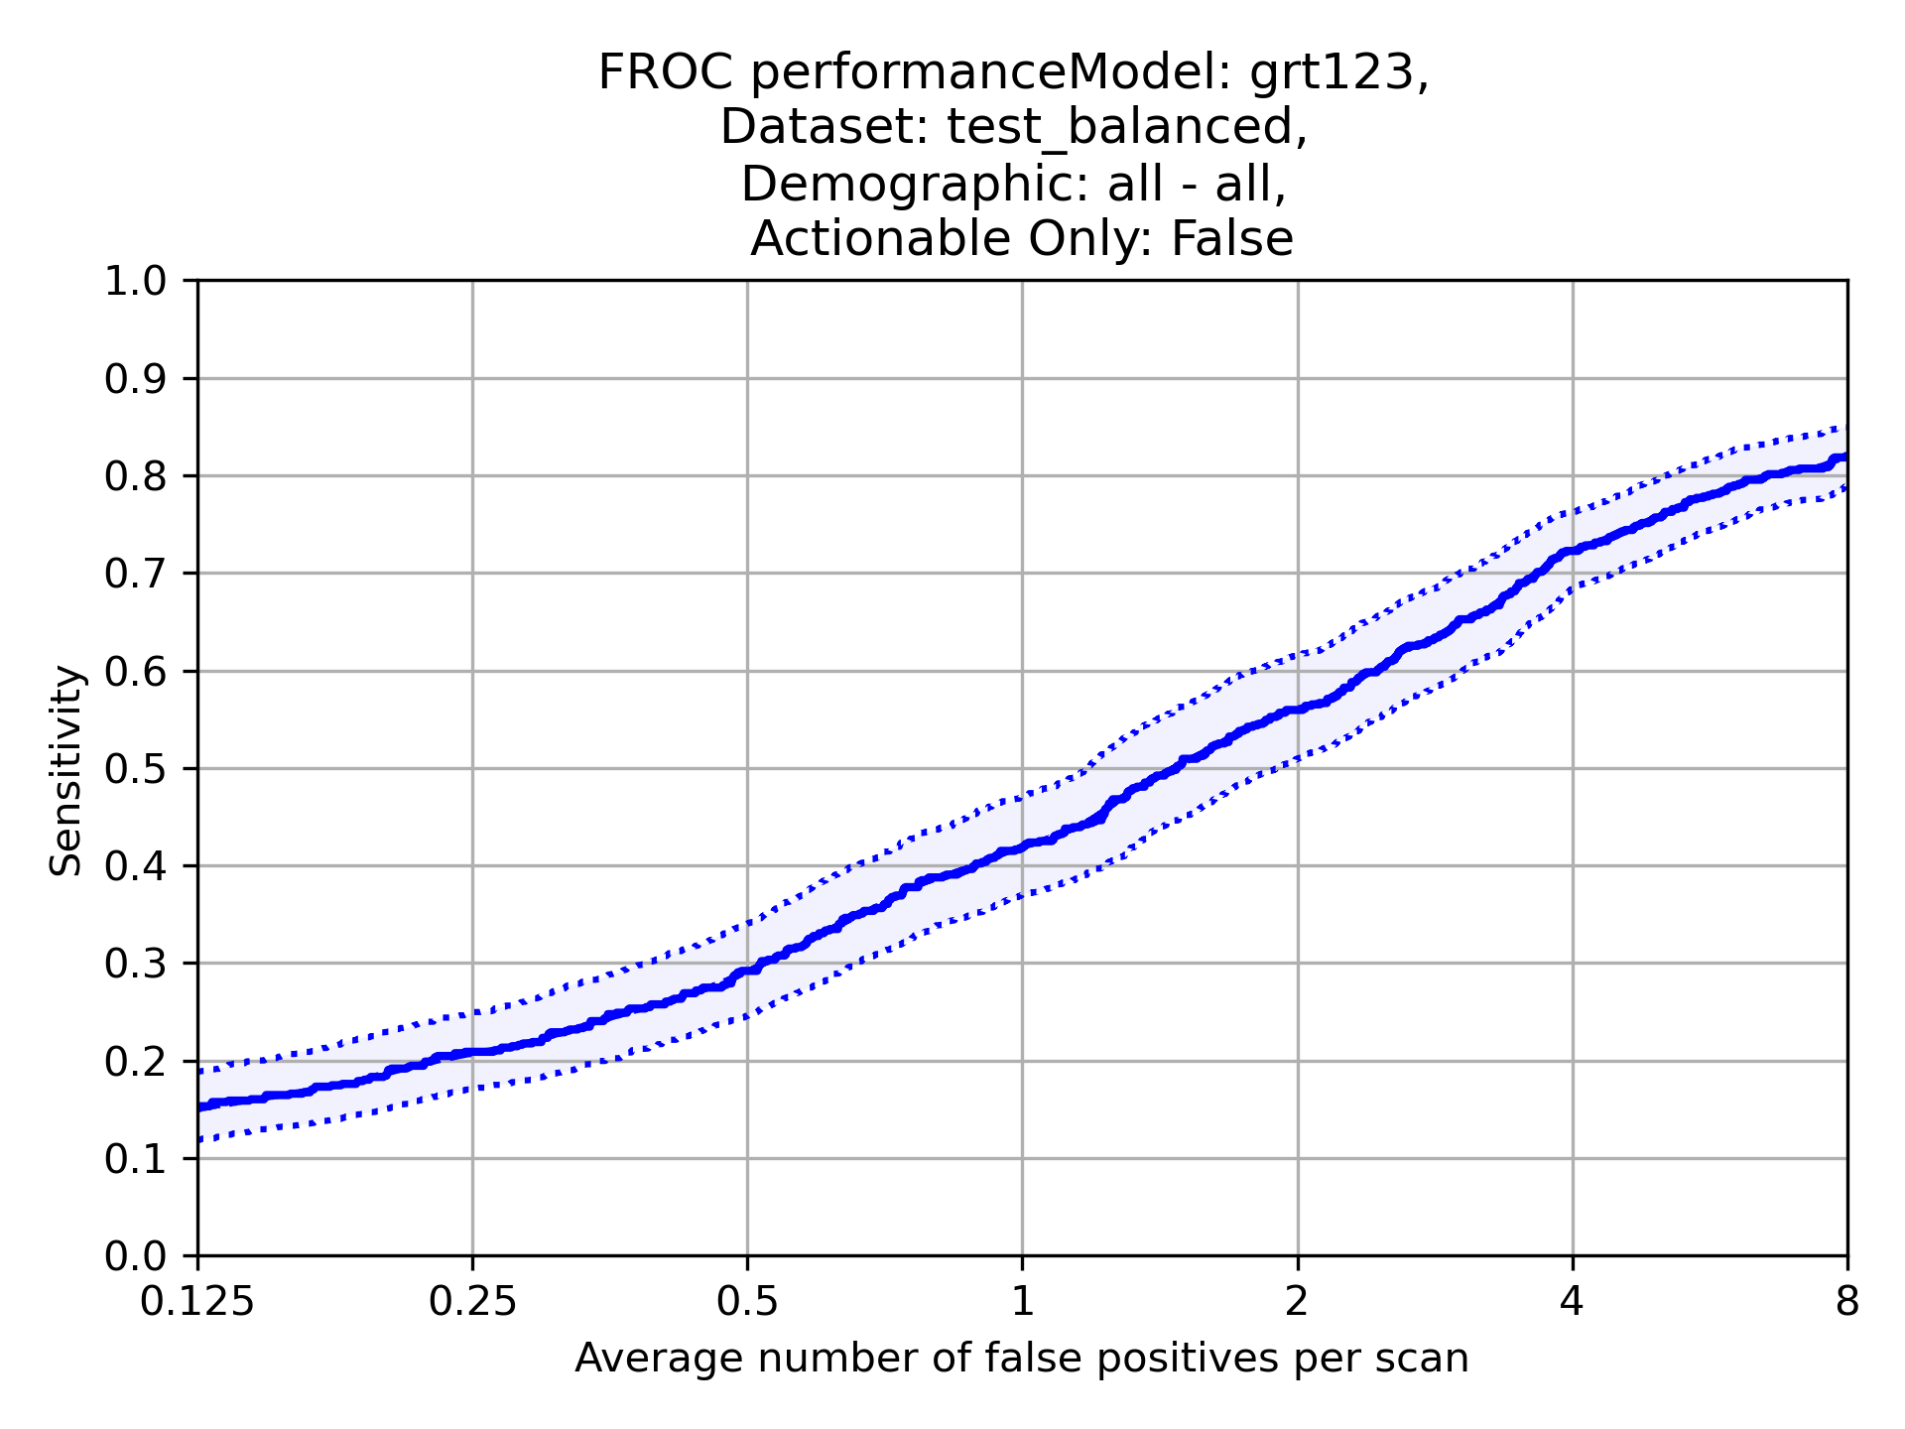
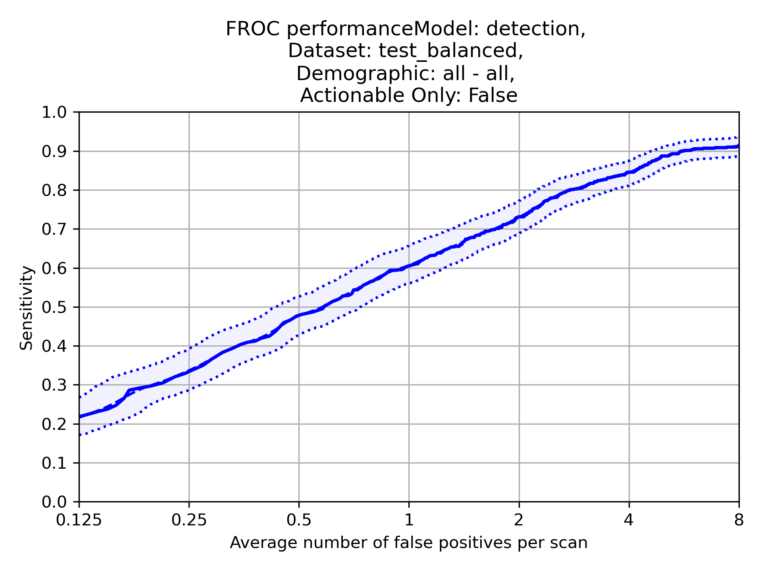
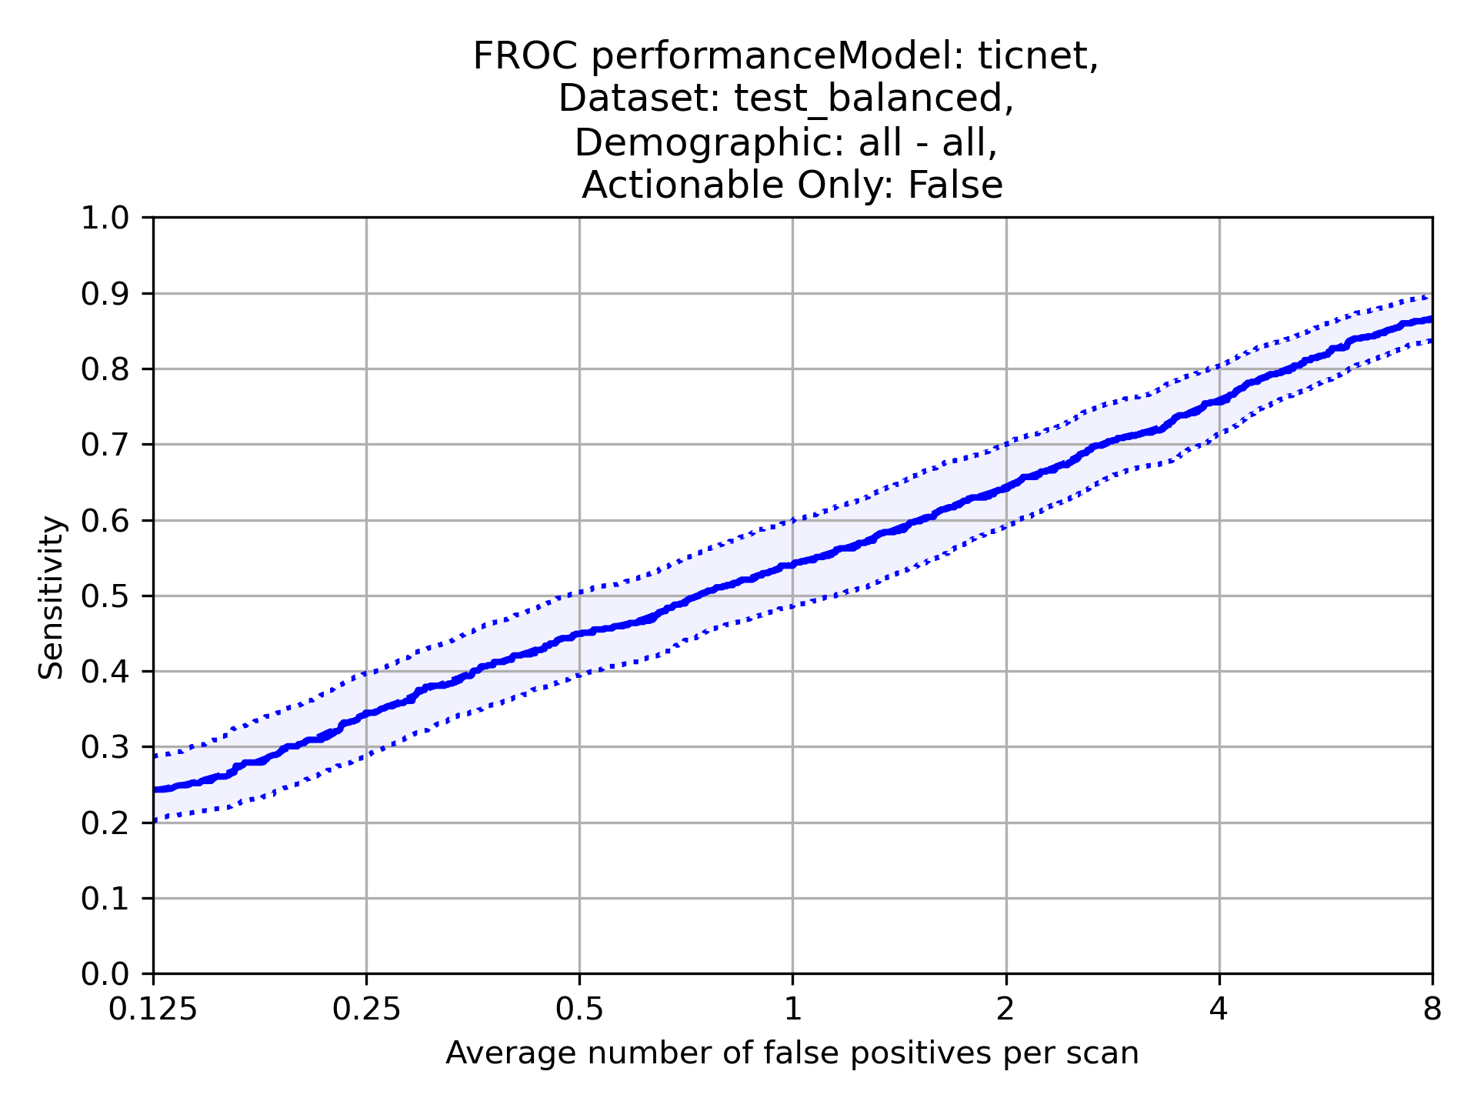
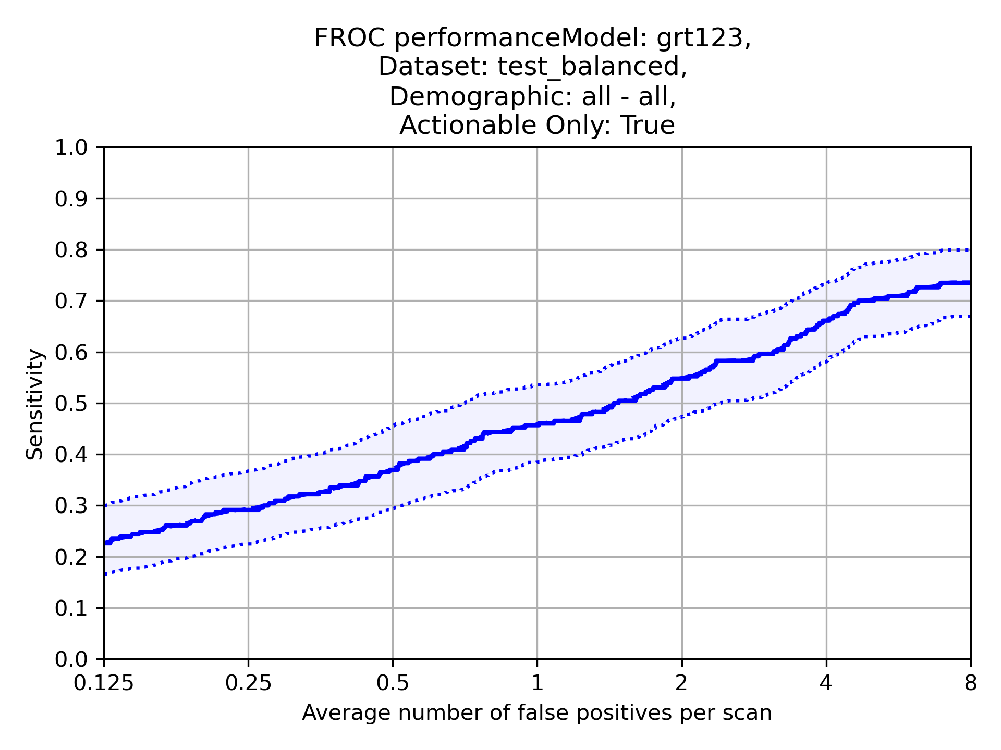
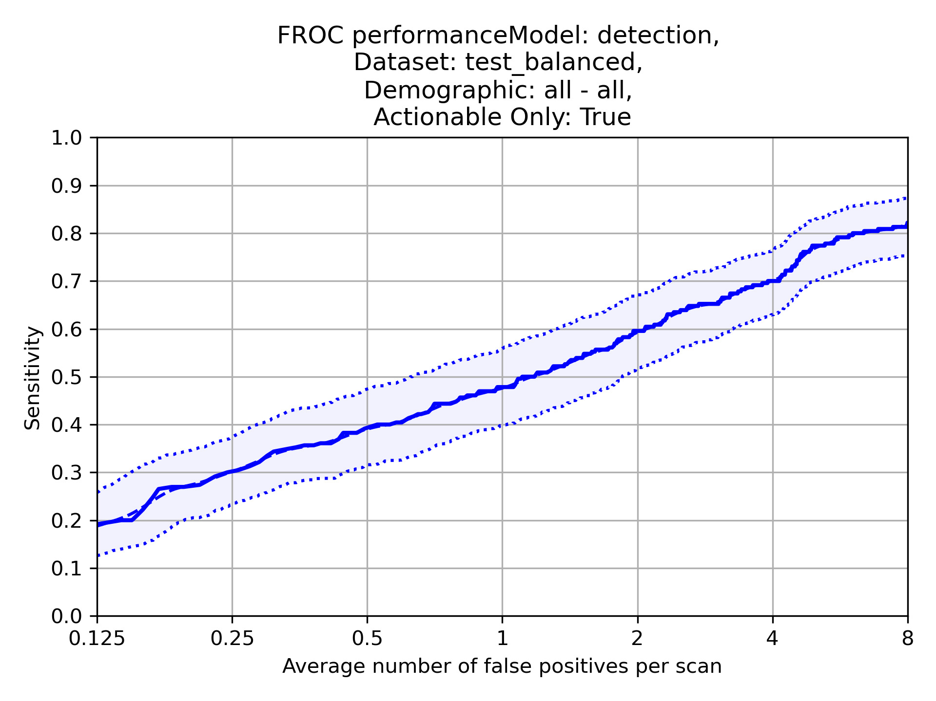
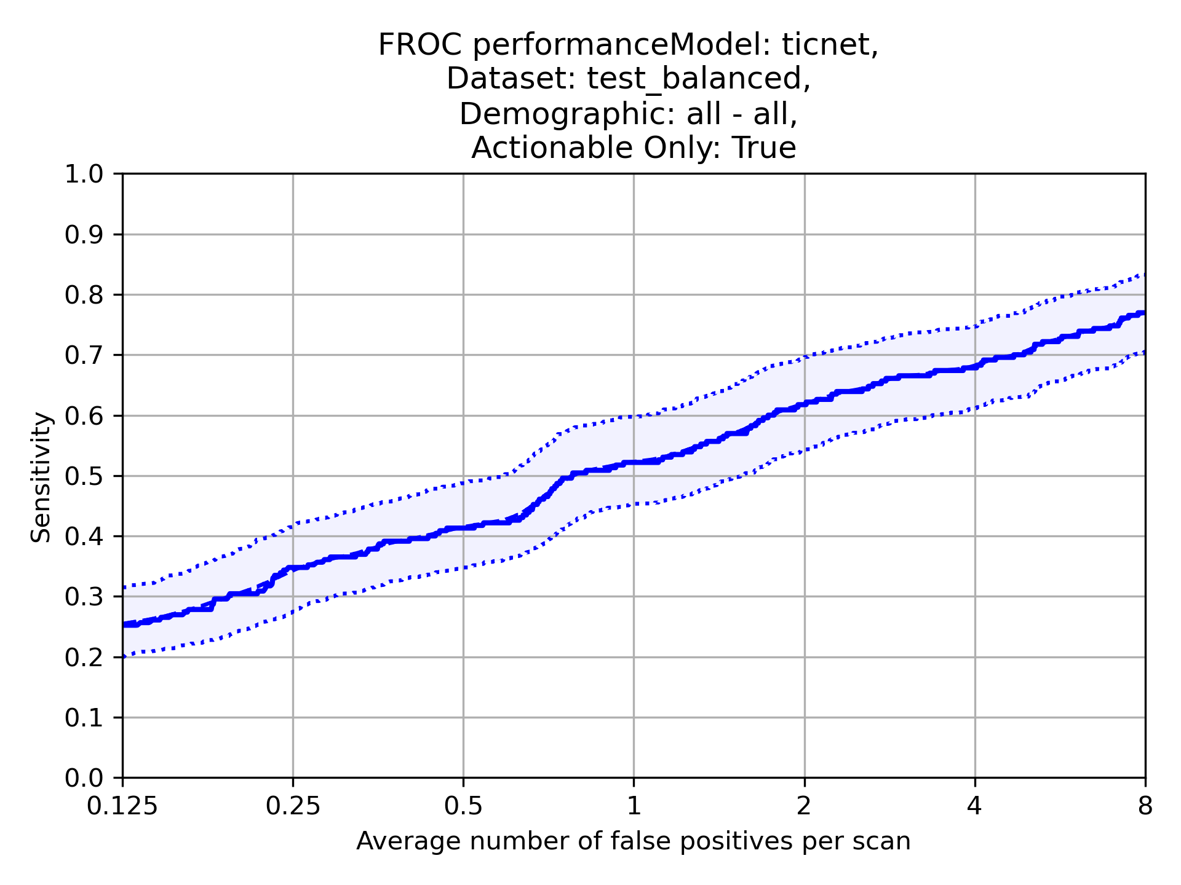
Sample: Test Balanced – FROC and CPM
Actionable and Non-Actionable
Scans: 594
Nodules: 699
CPM: 0.45 (95% CI 0.41-0.50)
CPM: 0.59 (95% CI 0.55-0.63)
CPM: 0.55 (95% CI 0.5-0.6)
Actionable only
Scans: 594
Nodules: 230
CPM: 0.44 (95% CI 0.36-0.51)
CPM: 0.42 (95% CI 0.36-0.49)
CPM: 0.37 (95% CI 0.29-0.45)

Slide 3
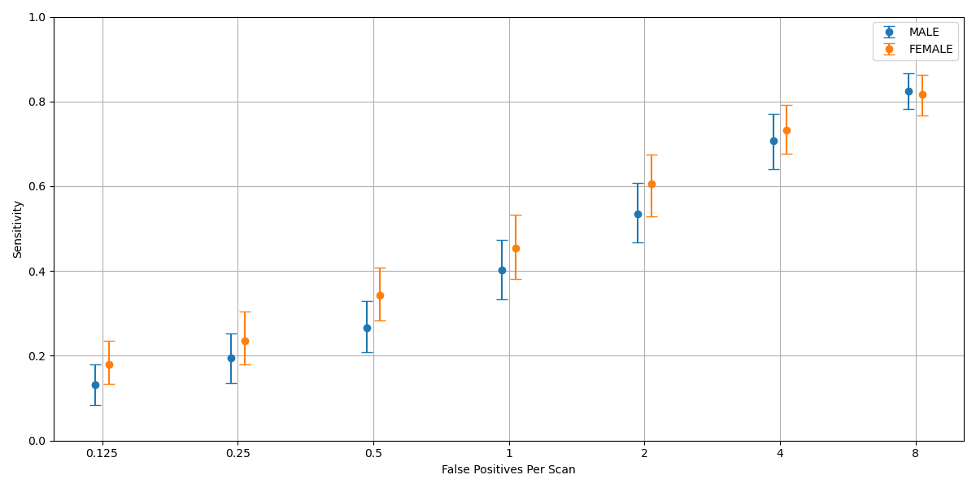
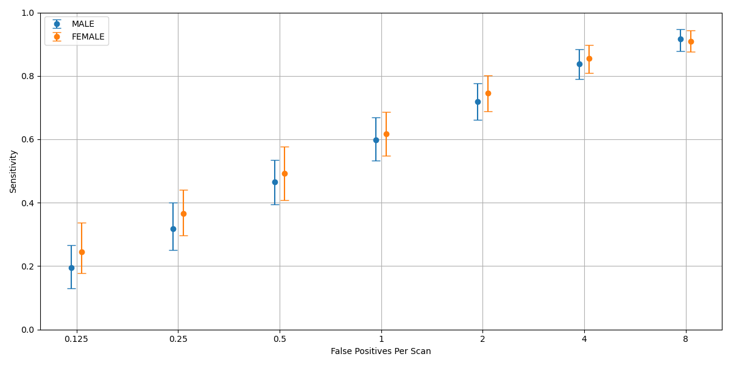
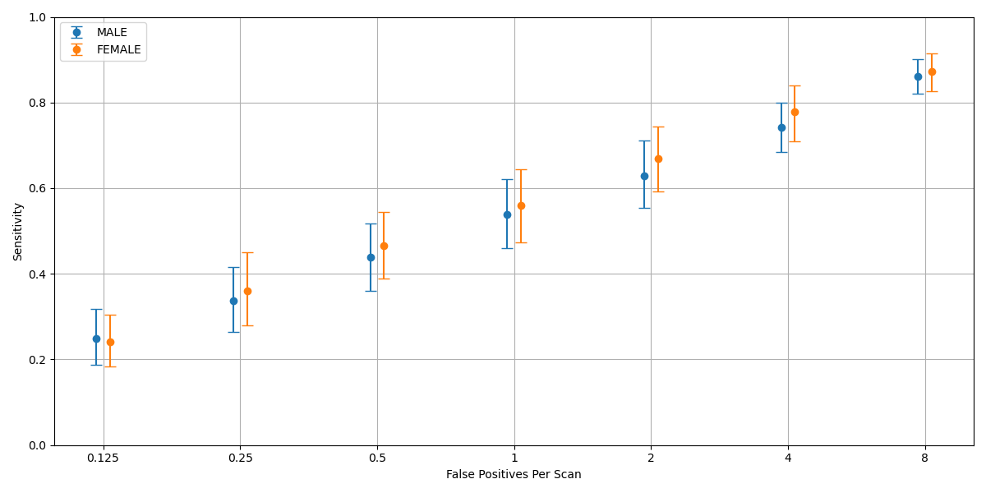
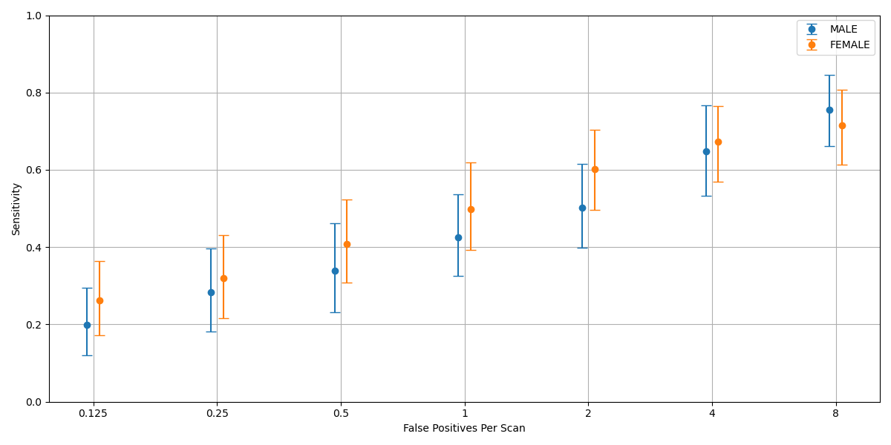
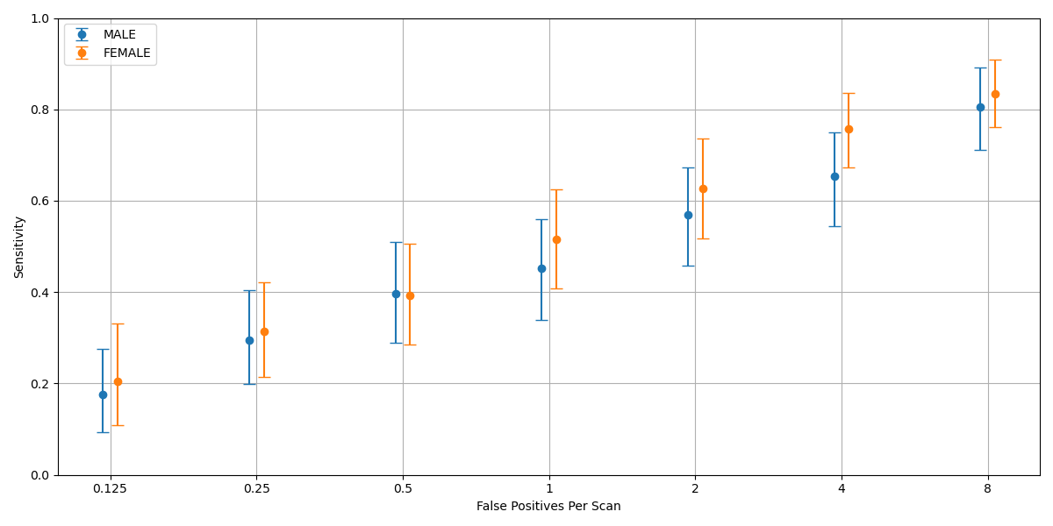
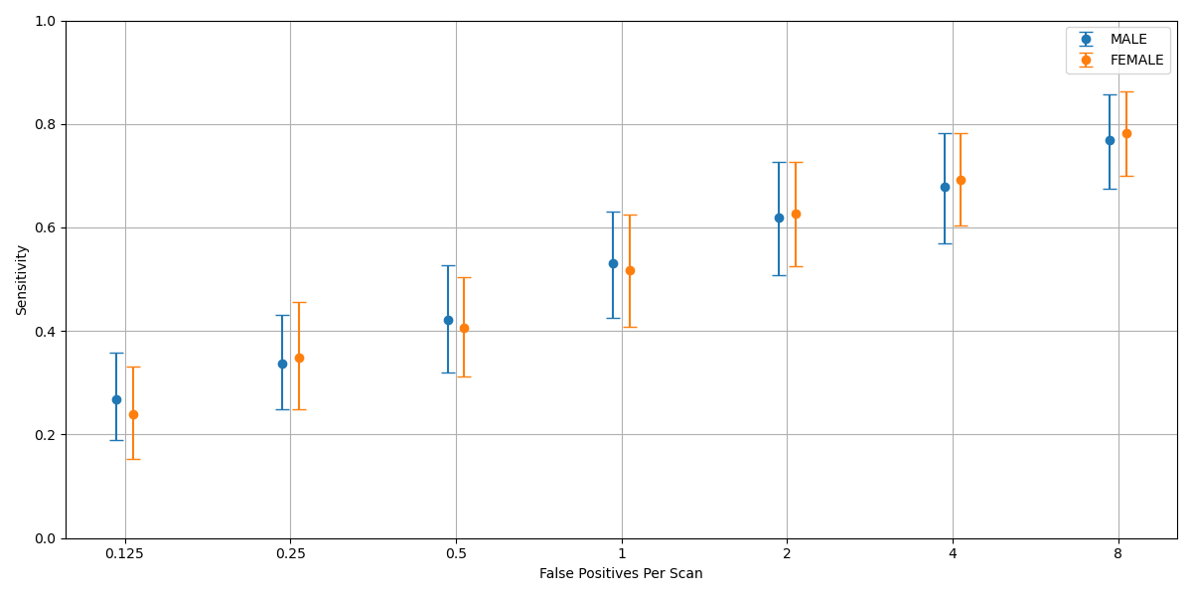
Sample: Test Balanced – Gender Splits – FROC and CPM
Model: Grt123
Model: Detection
Model: TiCNet
Actionable and Non-Actionable
Male Scans: 344
Male Nodules: 400
Female Scans: 250
Female Nodules: 299
Male CPM:0.44 (95% CI 0.38-0.50)
Female CPM: 0.48 (95% CI 0.42-0.54)
Male CPM:0.58 (95% CI 0.52-0.64)
Female CPM: 0.6 (95% CI 0.54-0.67)
Male CPM: 0.54 (95% CI 0.48-0.61) Female CPM: 0.56 (95% CI 0.49-0.63)
Model: Grt123
Model: Detection
Model: TiCNet
Actionable only
Male Scans: 344
Male Nodules: 120
Female Scans: 250
Female Nodules: 110
Male CPM:0.45 (95% CI 0.35-0.56)
Female CPM: 0.5 (95% CI 0.4-0.60)
Male CPM:0.48 (95% CI 0.38-0.58)
Female CPM: 0.52 (95% CI 0.42-0.62)
Male CPM:0.52 (95% CI 0.42-0.62)
Female CPM: 0.52 (95% CI 0.42-0.61)

Slide 4
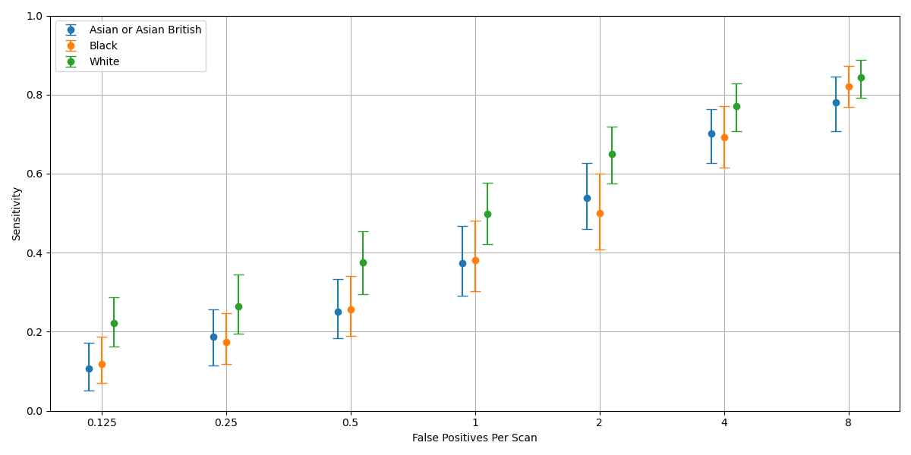
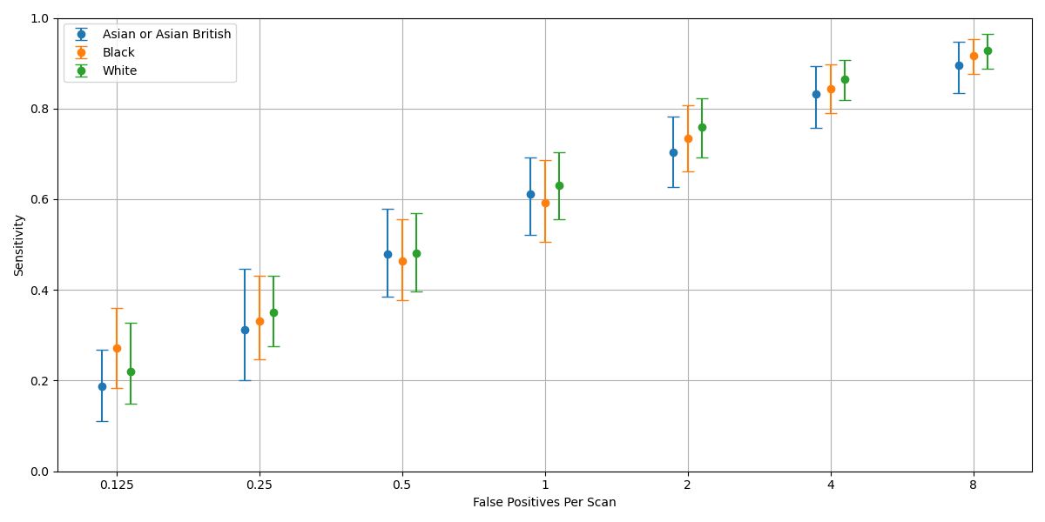
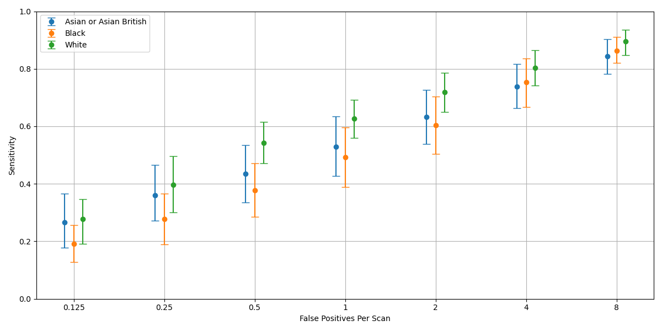
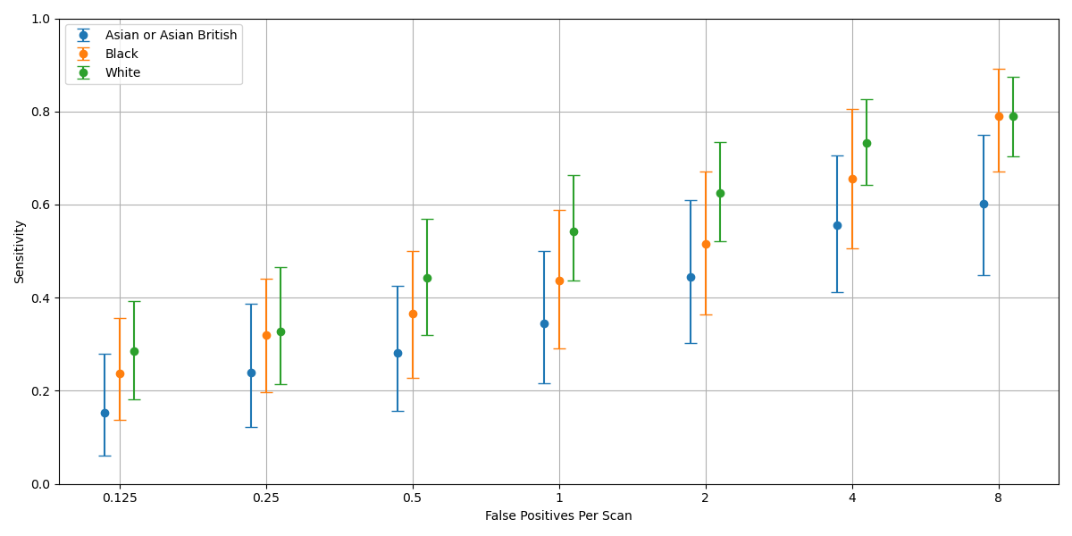
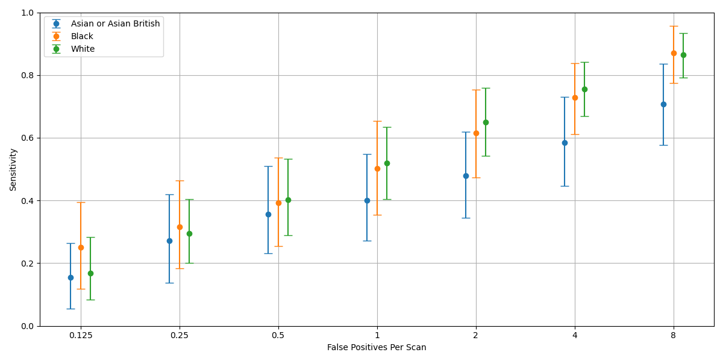
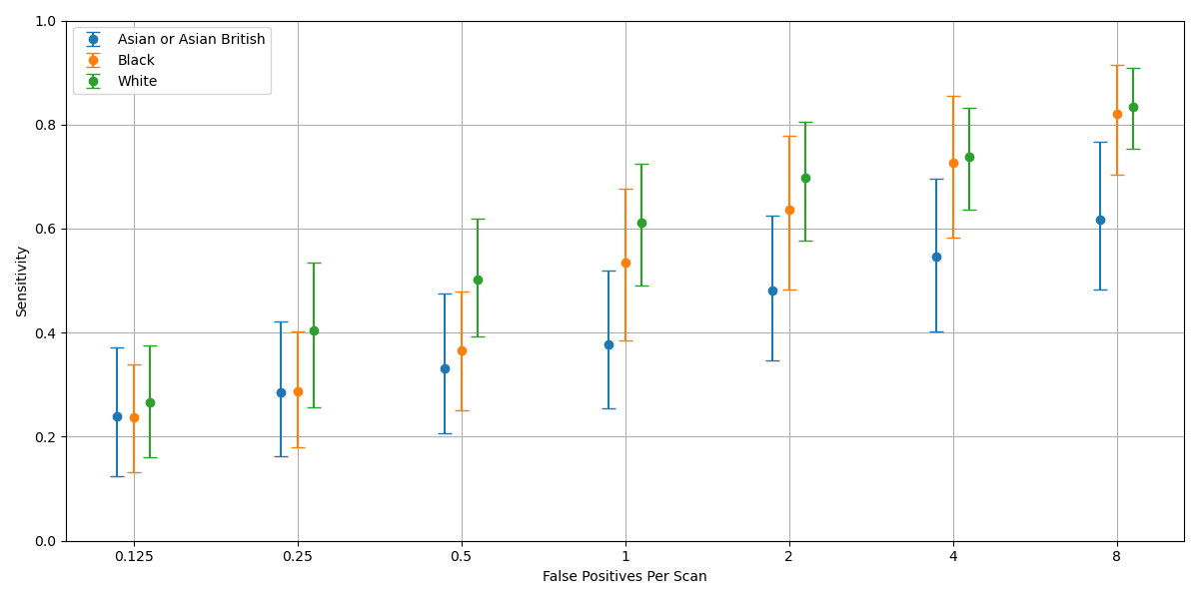
Sample: Test Balanced – Ethnic Group Splits – FROC and CPM
Model: Grt123
Model: Detection
Model: TiCNet
Actionable and Non-Actionable
Asian Scans: 198
Asian Nodules: 207
Black Scans: 198
Black Nodules: 250
White Scans: 198
White Nodules: 242
Asian CPM: 0.42 (95% CI 0.35-0.49)
Black CPM: 0.42 (95% CI 0.35-0.5)
White CPM: 0.52 (95% CI 0.45-0.59)
Asian CPM: 0.57 (95% CI 0.49-0.66)
Black CPM: 0.59 (95% CI 0.52-0.67)
White CPM: 0.60 (95% CI 0.54-0.68)
Asian CPM: 0.54 (95% CI 0.46-0.64)
Black CPM: 0.51 (95% CI 0.43-0.59)
White CPM: 0.61 (95% CI 0.54-0.68)
Actionable only
Asian Scans: 198
Asian Nodules: 65
Black Scans: 198
Black Nodules: 62
White Scans: 198
White Nodules: 103
Asian CPM: 0.37 (95% CI 0.25-0.52)
Black CPM: 0.47 (95% CI 0.34-0.61)
White CPM: 0.54 (95% CI 0.43-0.65)
Asian CPM: 0.42 (95% CI 0.29-0.56)
Black CPM: 0.52 (95% CI 0.40-0.66)
White CPM: 0.52 (95% CI 0.43-0.63)
Asian CPM: 0.41 (95% CI 0.28-0.55)
Black CPM: 0.52 (95% CI 0.39-0.64)
White CPM: 0.58 (95% CI 0.47-0.69)

Slide 5
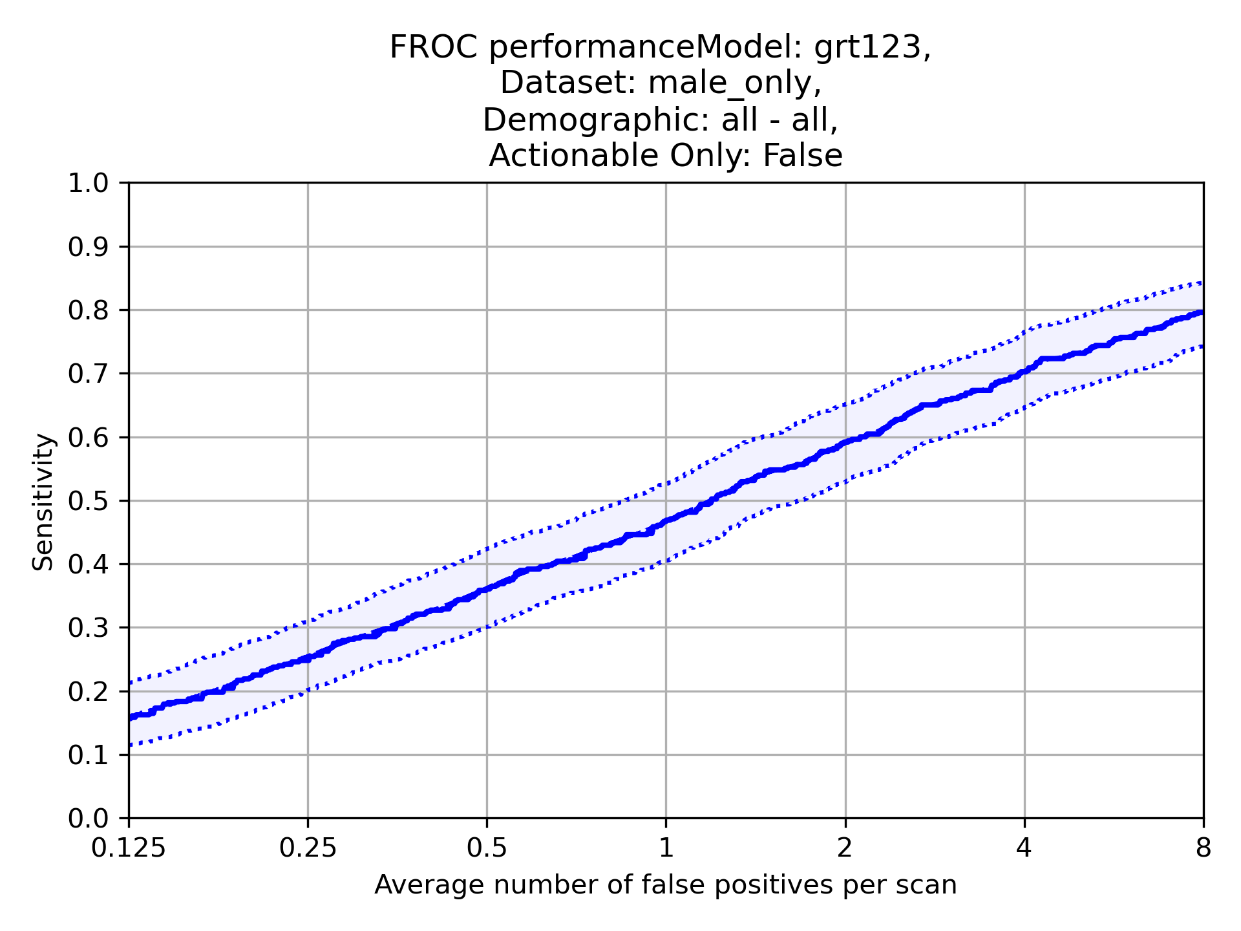
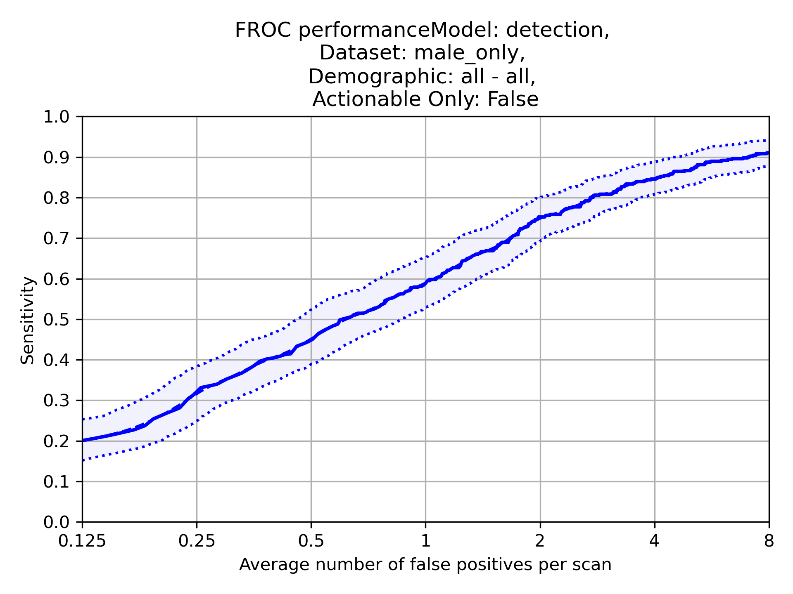
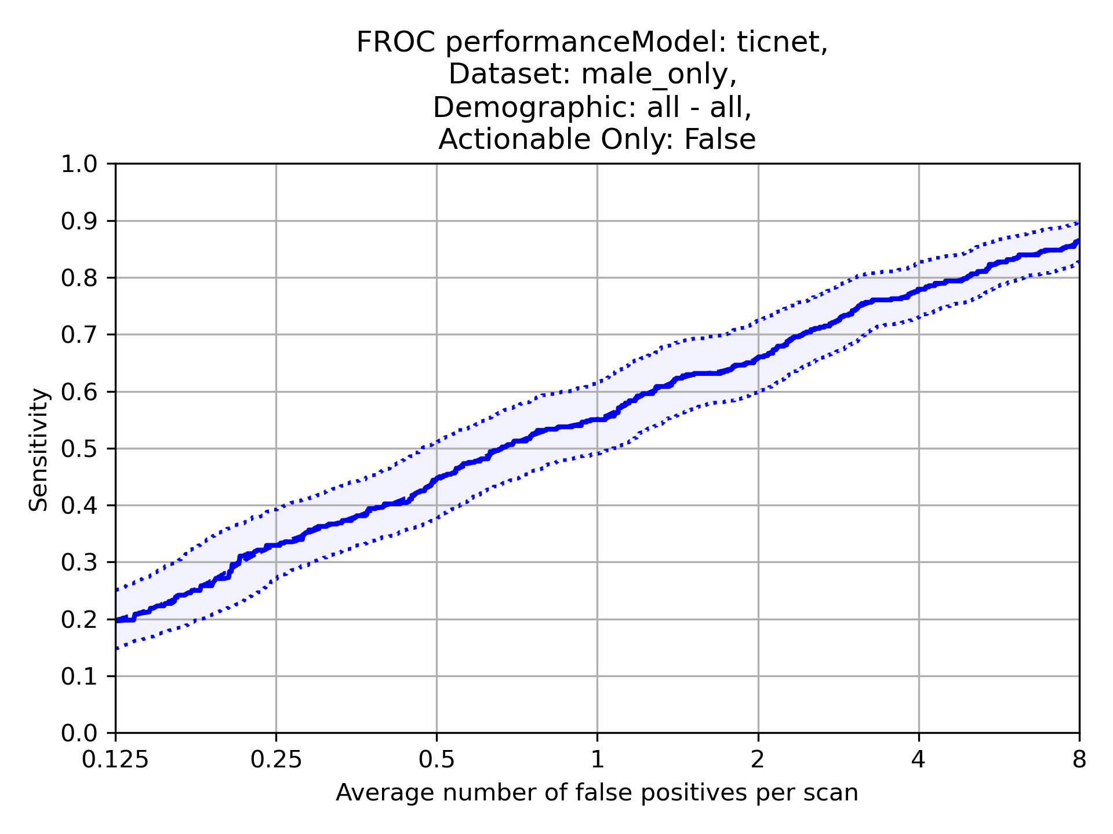
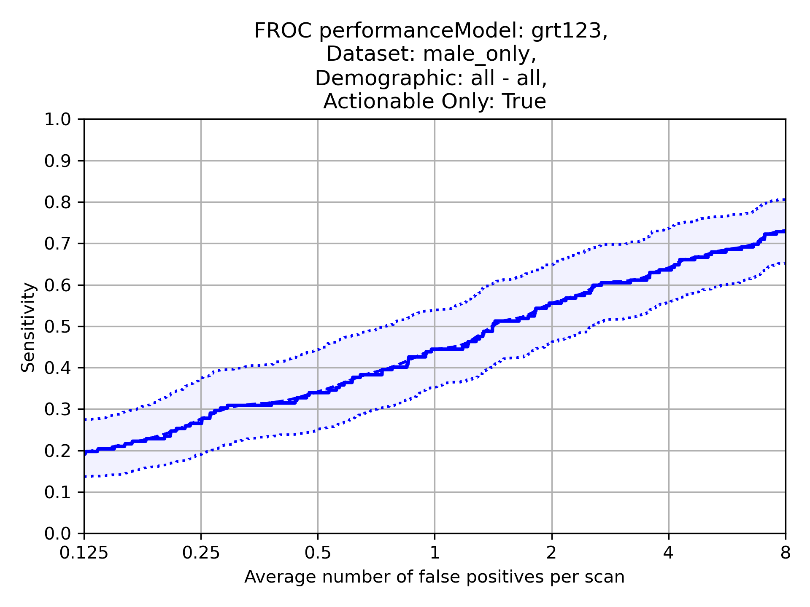
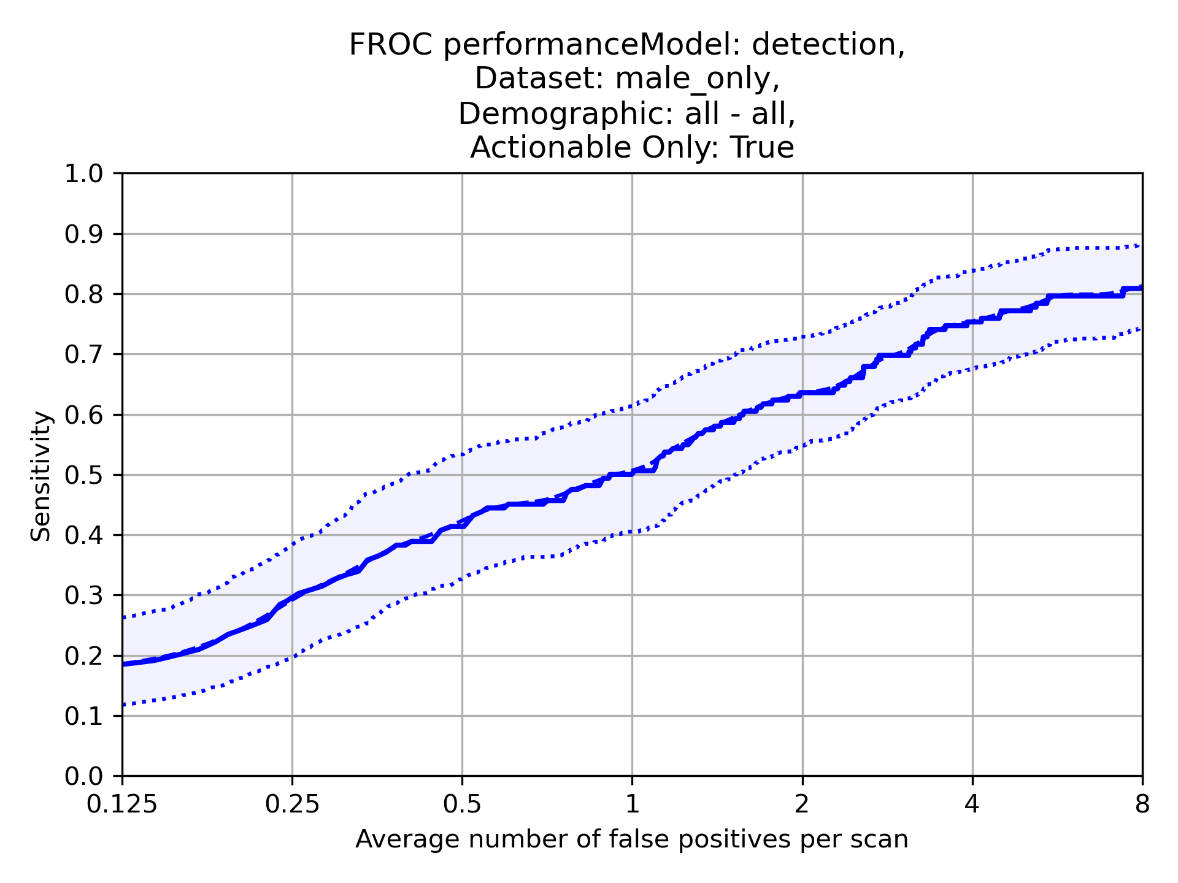
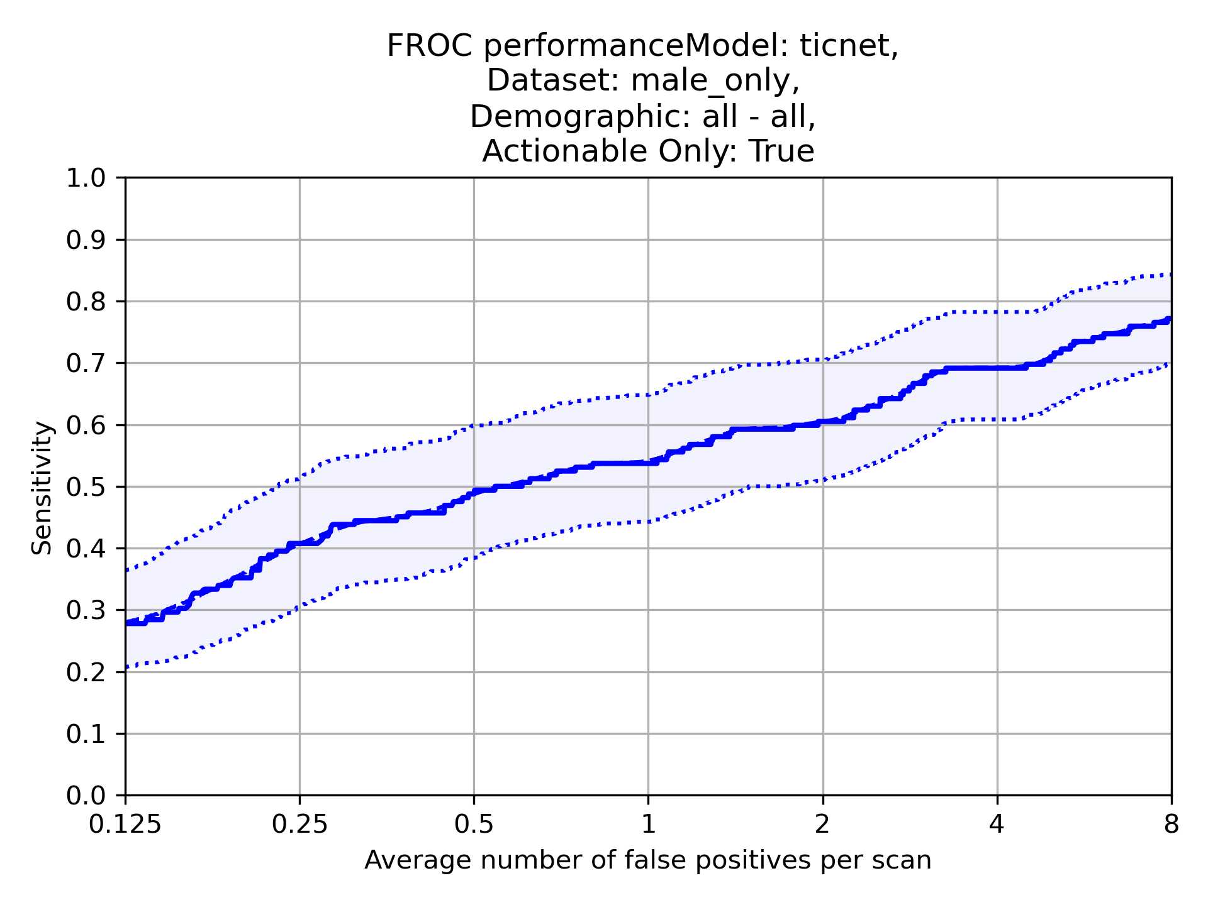
Sample: Male Only – FROC and CPM
Actionable and Non-Actionable
Scans:
Nodules:
CPM:0.48 (95% CI 0.42-0.53)
CPM:0.58 (95% CI 0.53-0.63)
CPM:0.55 (95% CI 0.49-0.6)
Actionable only
Scans:
Nodules:
CPM:0.45 (95% CI 0.37-0.55)
CPM:0.52 (95% CI 0.43-0.61)
CPM:0.54 (95% CI 0.45-0.64)

Slide 6
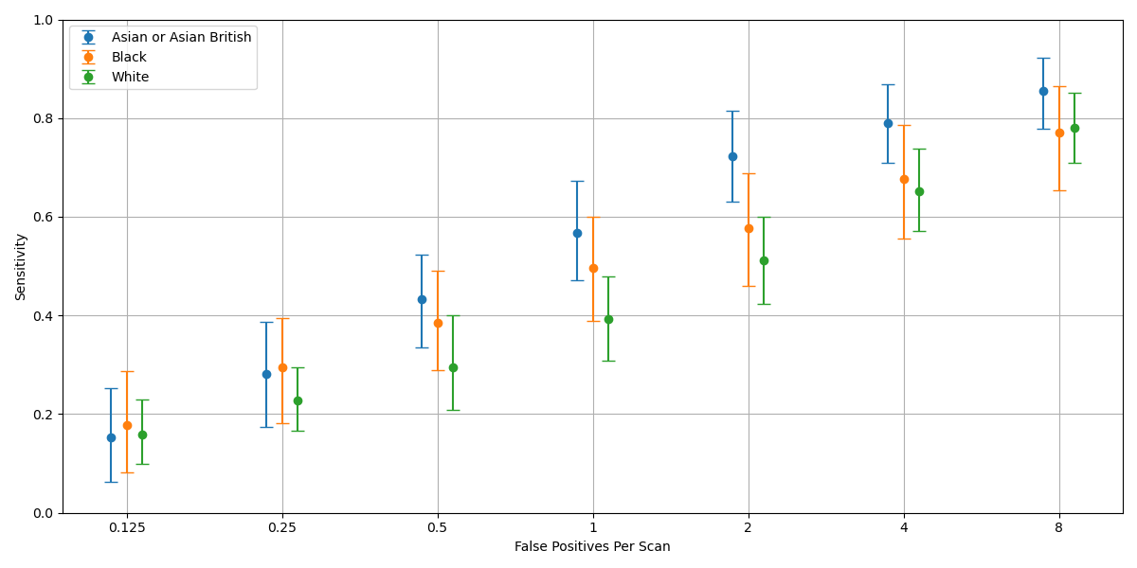
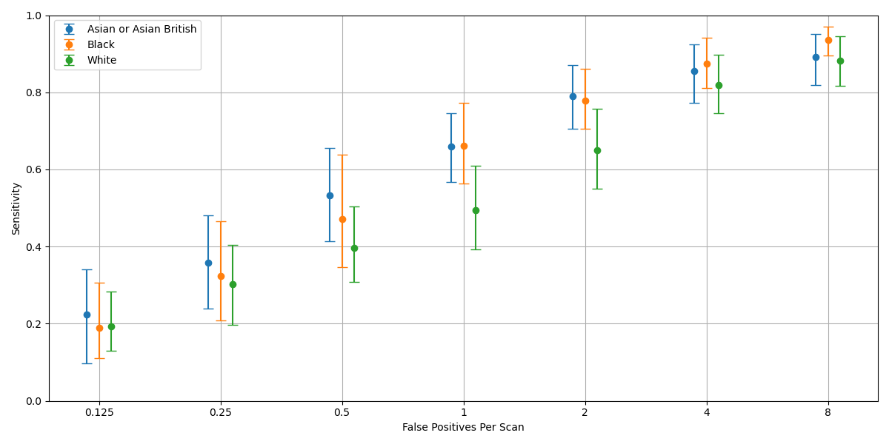
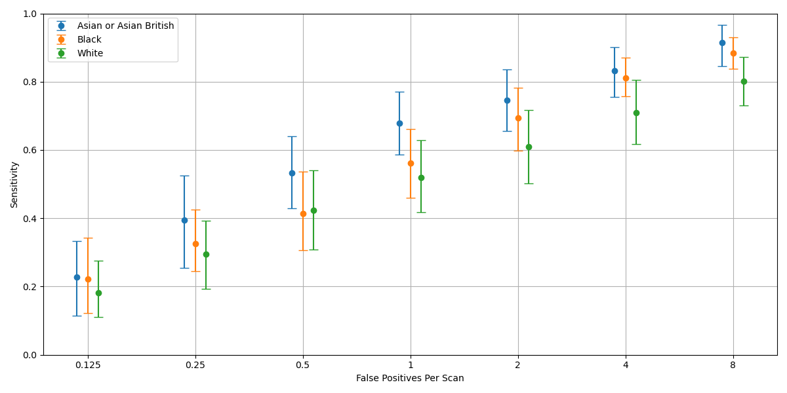
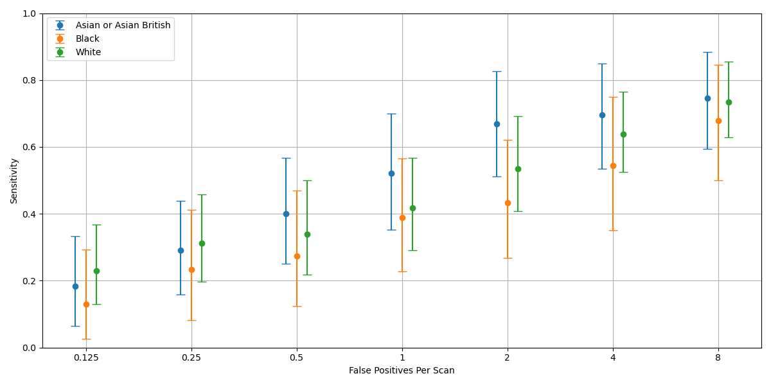
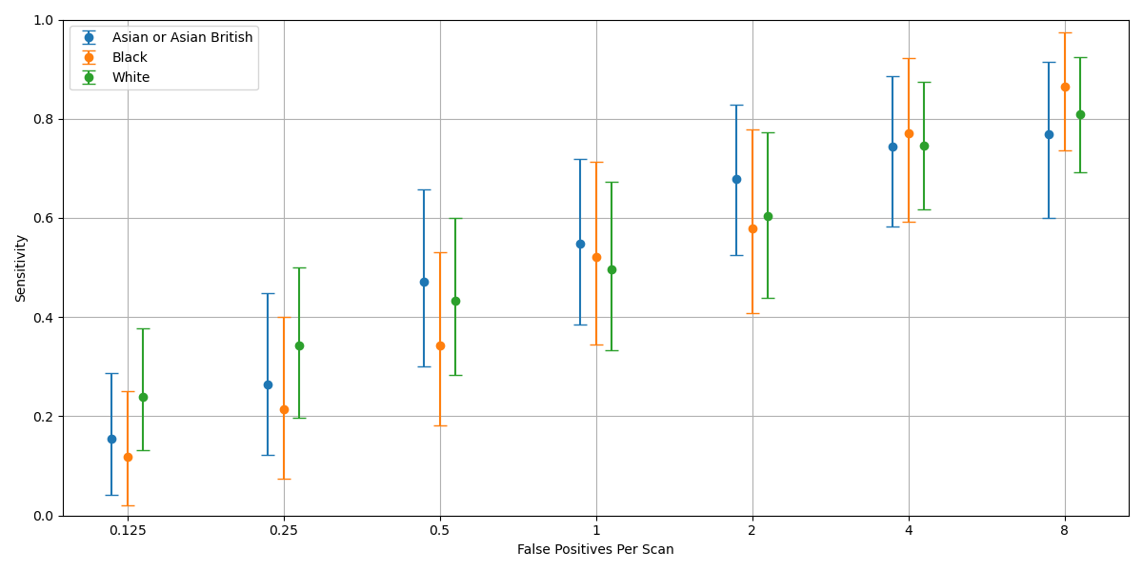
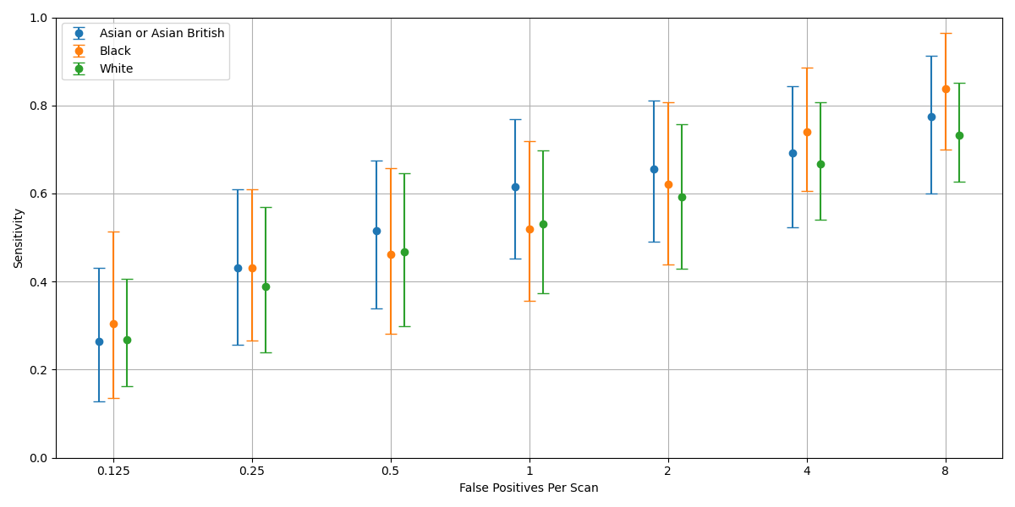
Sample: Male Only – Ethnic Group Splits – FROC and CPM
Model: Grt123
Model: Detection
Model: TiCNet
Actionable and Non-Actionable
Asian Scans: 140
Asian Nodules: 121
Black Scans: 140
Black Nodules: 171
White Scans: 140
White Nodules: 188
Asian or Asian British | 0.54 (95% CI 0.45-0.63)
Black | 0.48 (95% CI 0.37-0.59)
White | 0.43 (95% CI 0.36-0.51)
Asian or Asian British | 0.62 (95% CI 0.52-0.71)
Black | 0.61 (95% CI 0.52-0.71)
White | 0.53 (95% CI 0.45-0.63)
Asian or Asian British | 0.62 (95% CI 0.52-0.71)
Black | 0.56 (95% CI 0.48-0.65)
White | 0.51 (95% CI 0.41-0.6)
Model: Grt123
Model: Detection
Model: TiCNet
Actionable only
Asian Scans: 140
Asian Nodules: 43
Black Scans: 140
Black Nodules: 37
White Scans: 140
White Nodules: 82
Asian or Asian British | 0.50 (95% CI 0.35-0.66)
Black | 0.38 (95% CI 0.23-0.57)
White | 0.46 (95% CI 0.34-0.6)
Asian or Asian British | 0.52 (95% CI 0.37-0.68)
Black | 0.49 (95% CI 0.34-0.65)
White | 0.52 (95% CI 0.38-0.67)
Asian or Asian British | 0.56 (95% CI 0.4-0.72)
Black | 0.56 (95% CI 0.4-0.74)
White | 0.52 (95% CI 0.38-0.68)

Slide 7
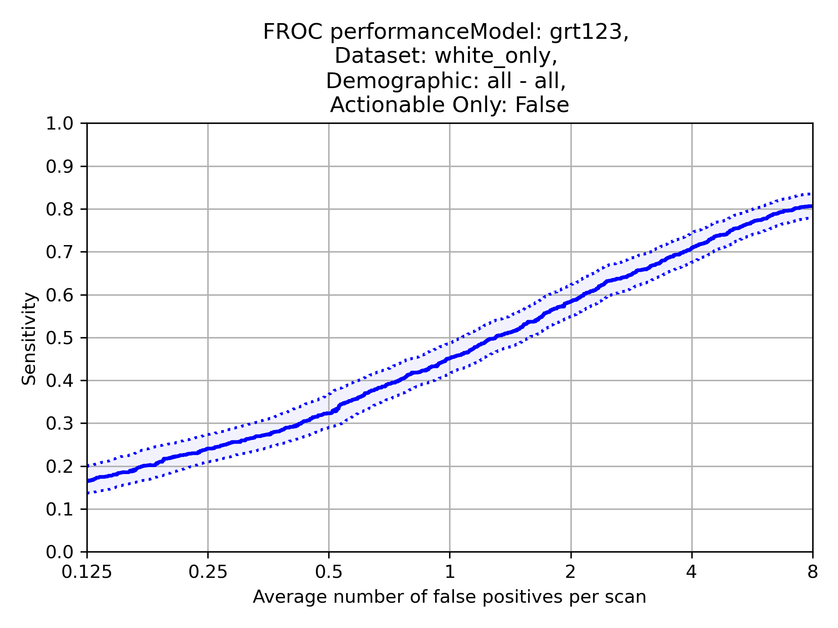
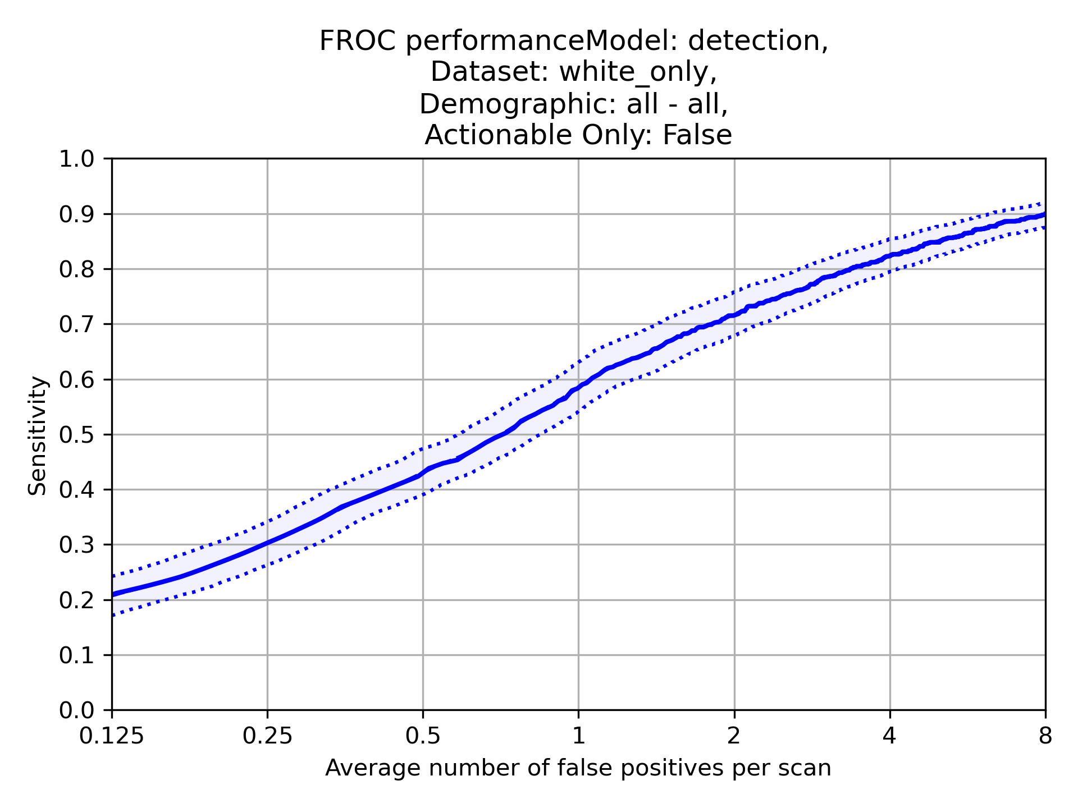
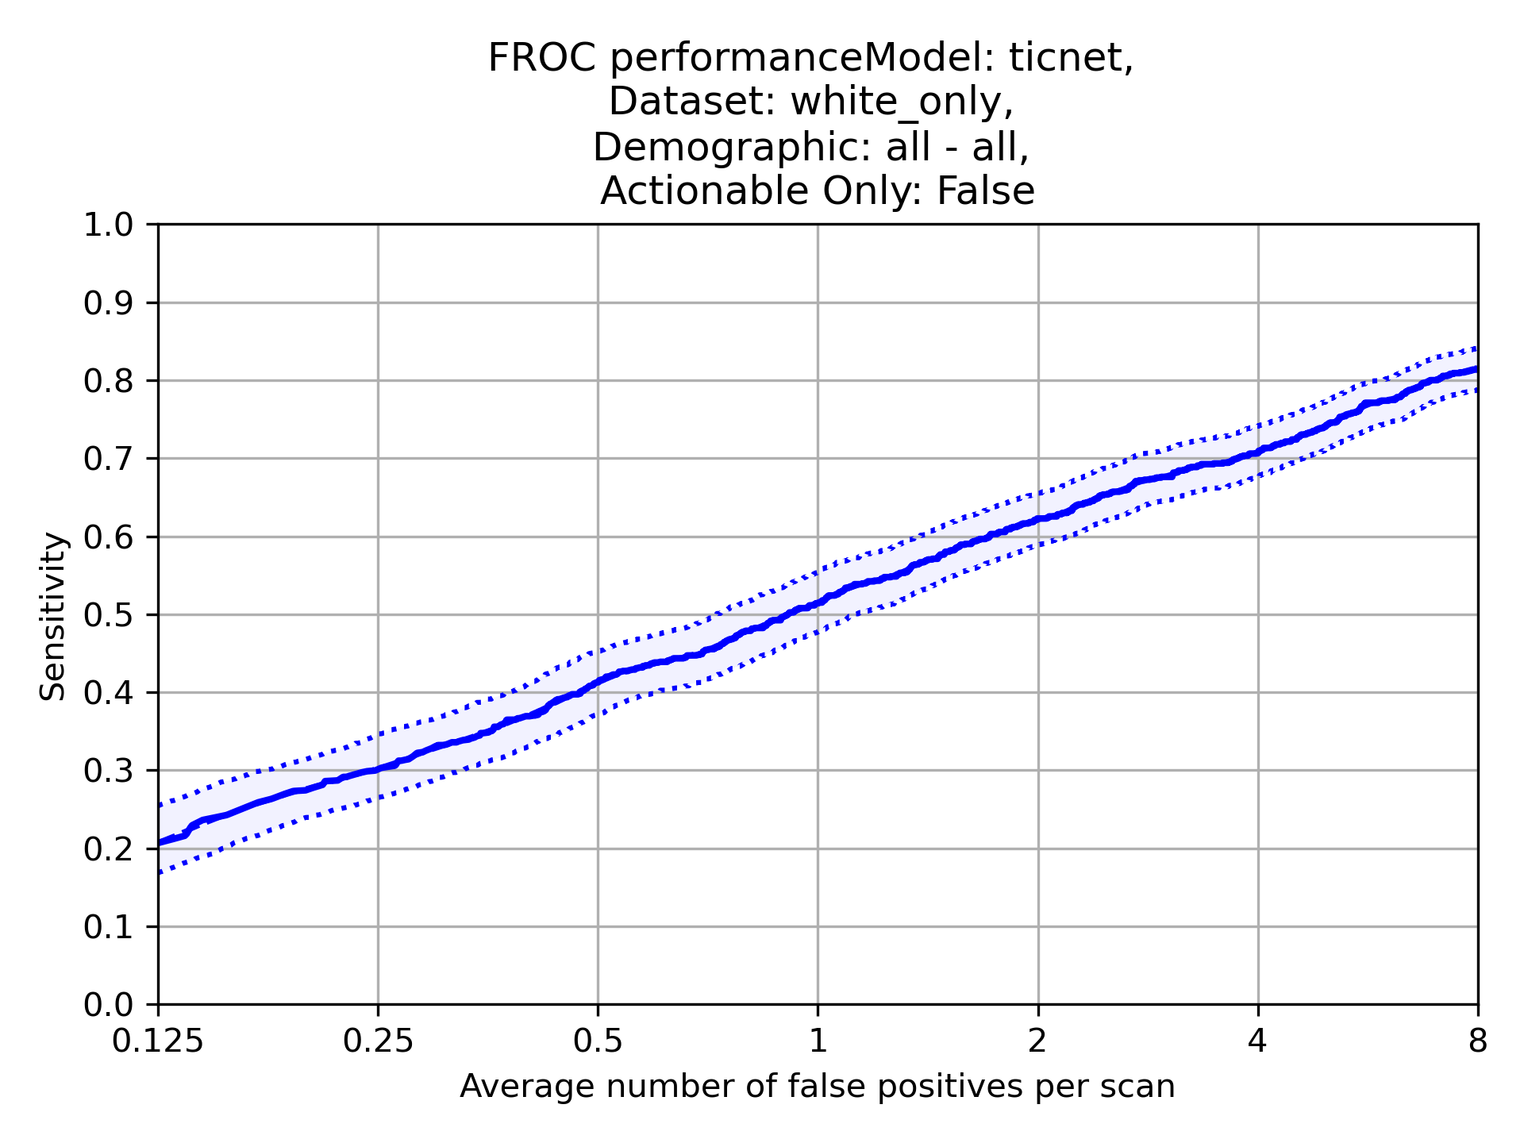
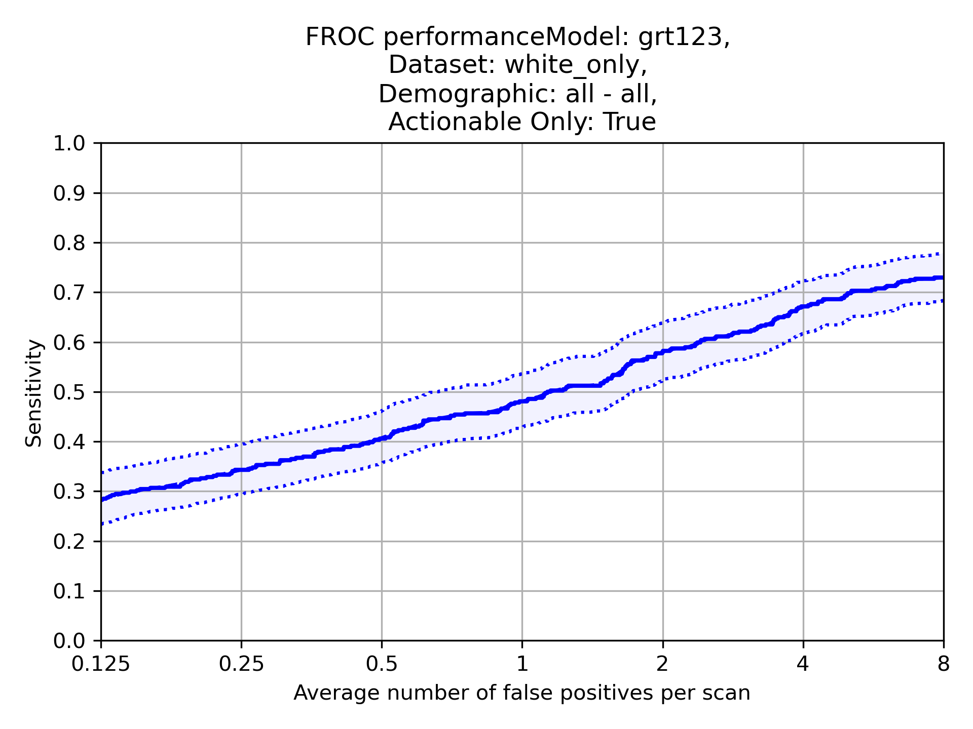
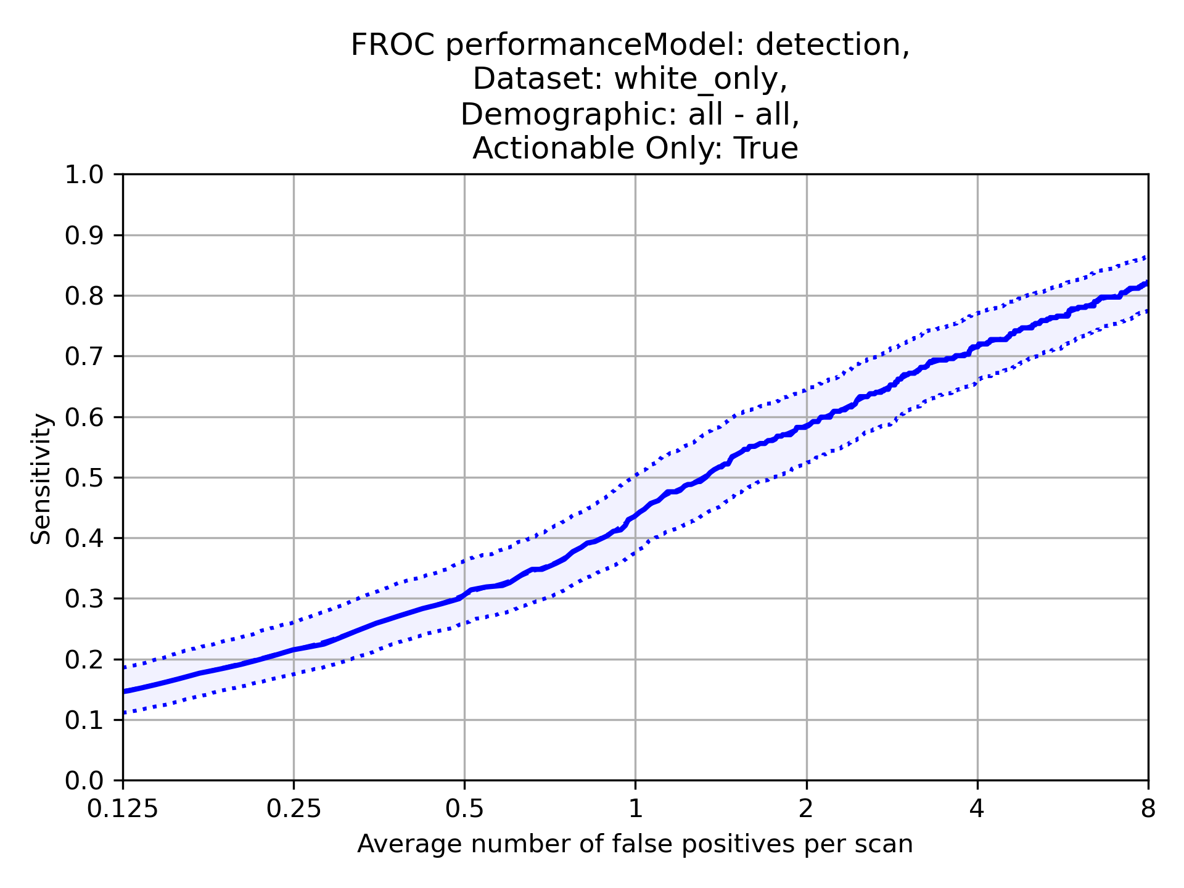
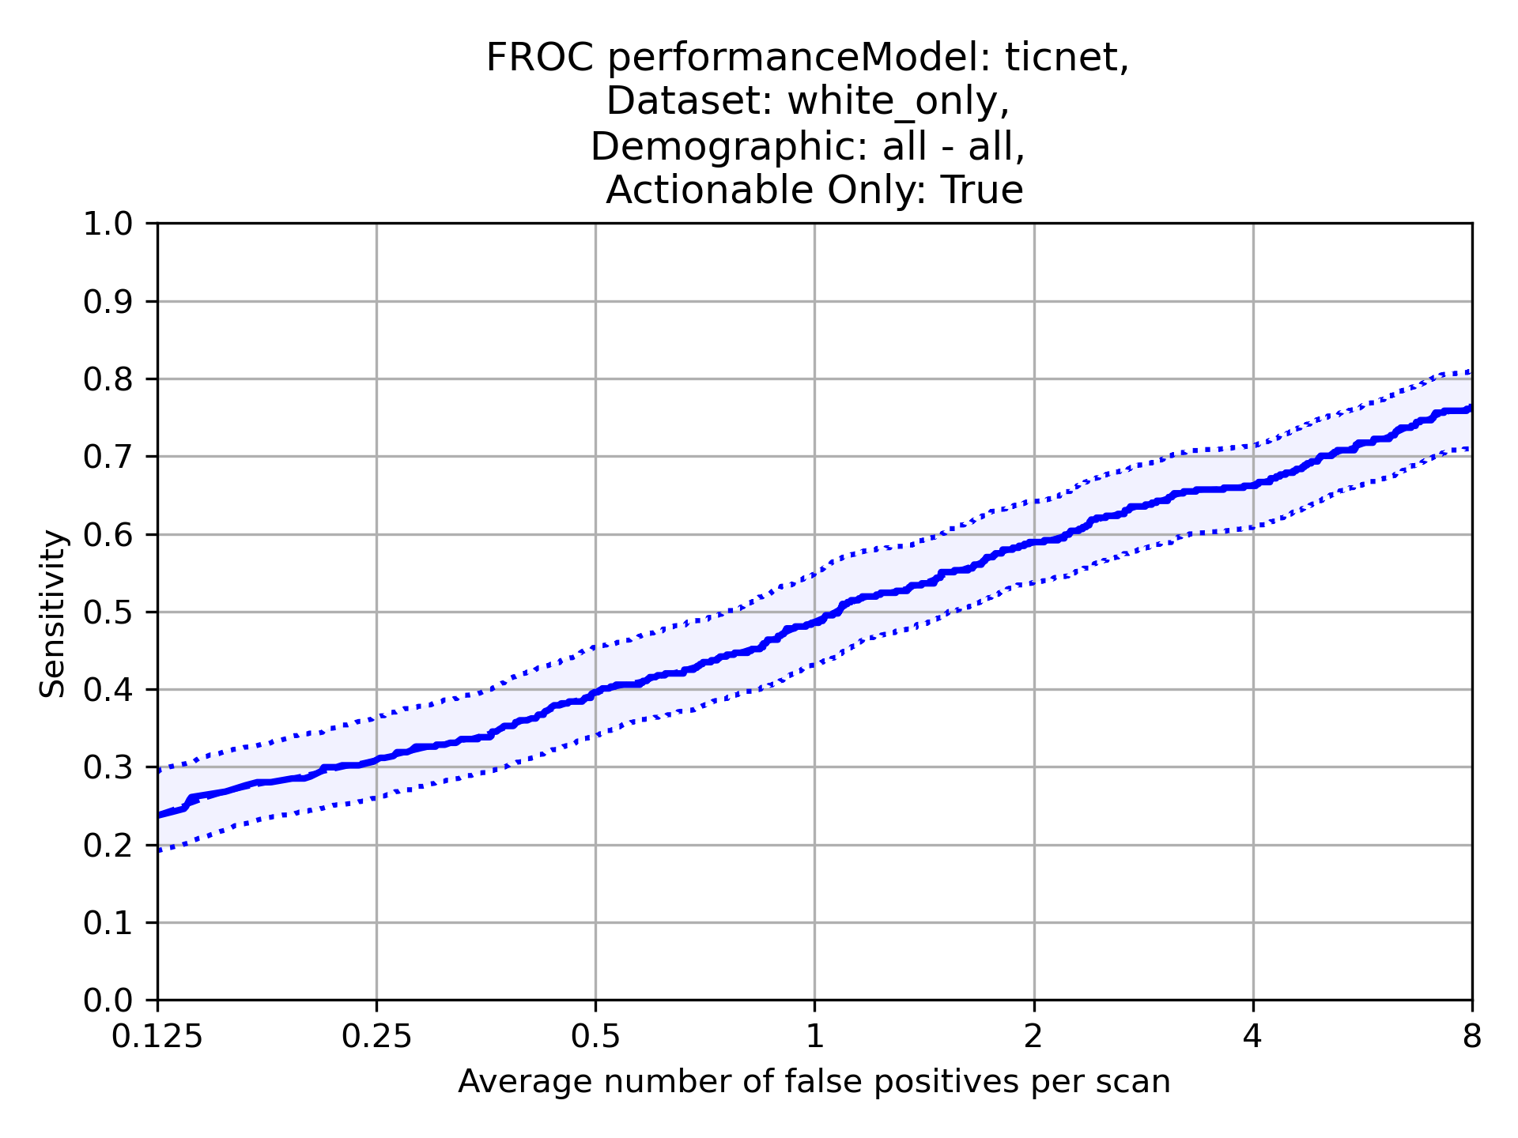
Sample: White Only – FROC and CPM
Actionable and Non-Actionable
Scans: 798
Nodules: 1105
CPM | 0.47 (95% CI 0.44-0.5)
CPM | 0.57 (95% CI 0.53-0.6)
CPM | 0.51 (95% CI 0.48-0.55)
Actionable only
Scans: 798
Nodules: 414
CPM | 0.5 (95% CI 0.45-0.55)
CPM | 0.46 (95% CI 0.41-0.51)
CPM | 0.49 (95% CI 0.44-0.55)

Slide 8
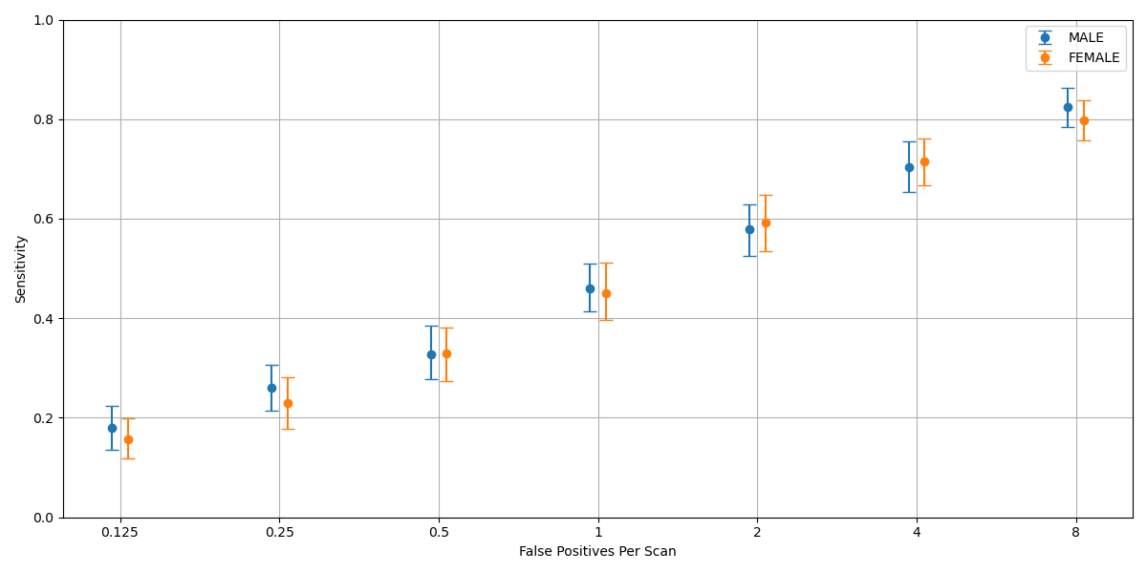
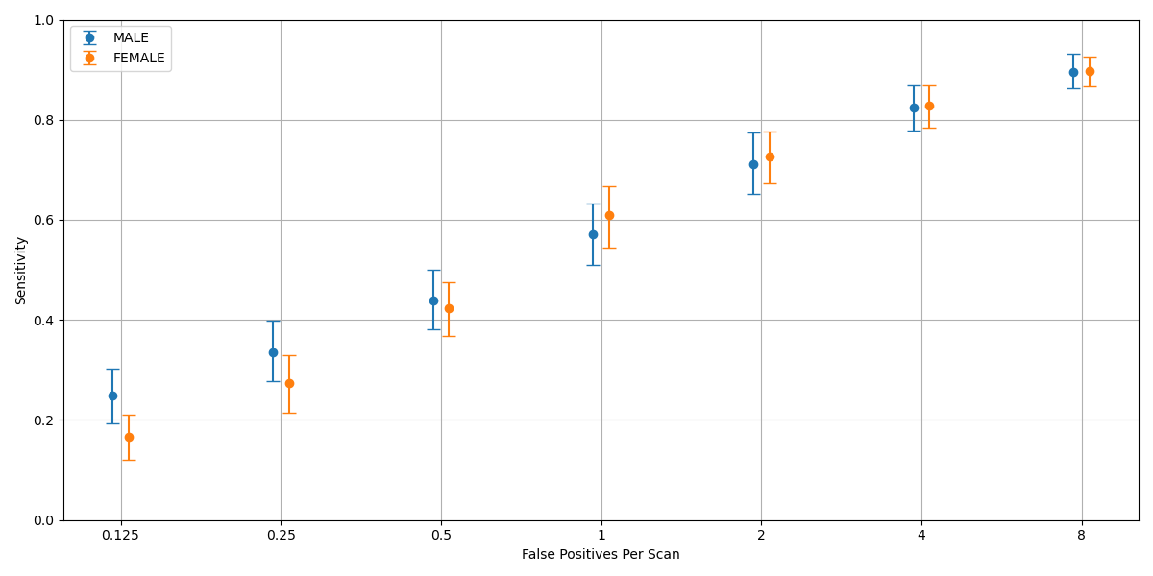
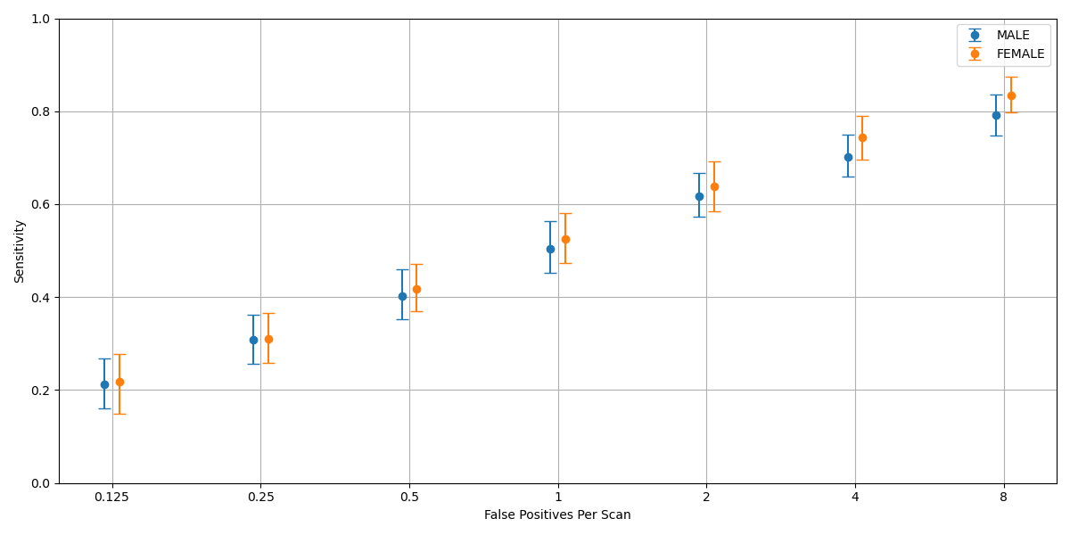
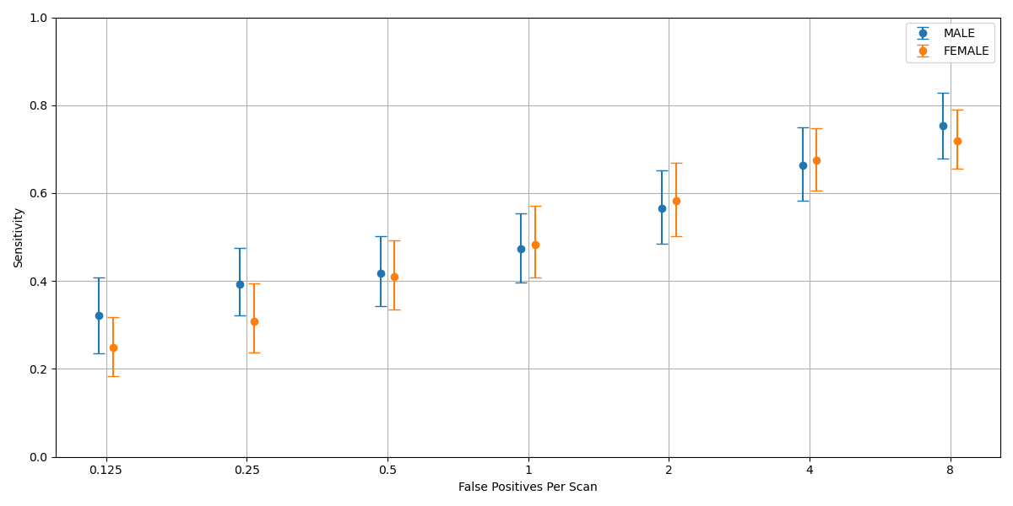
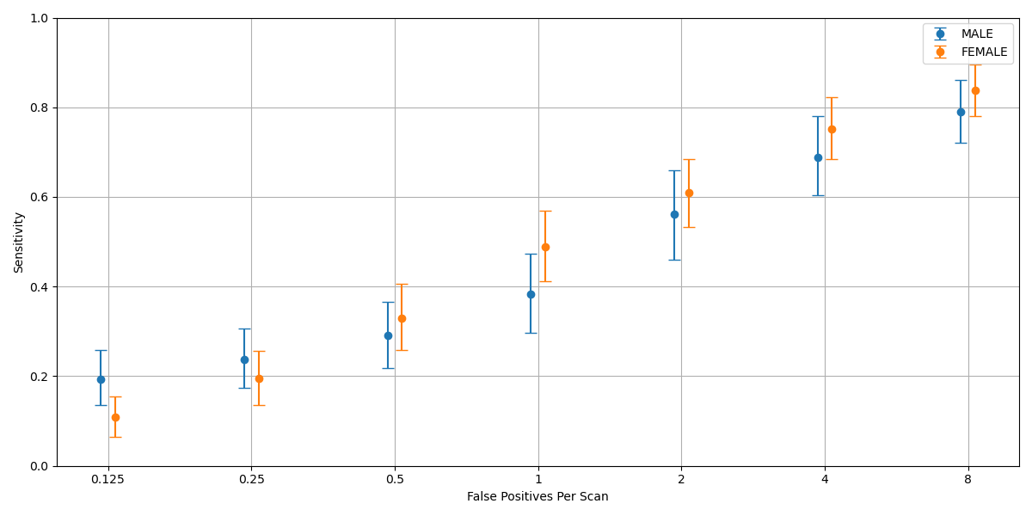
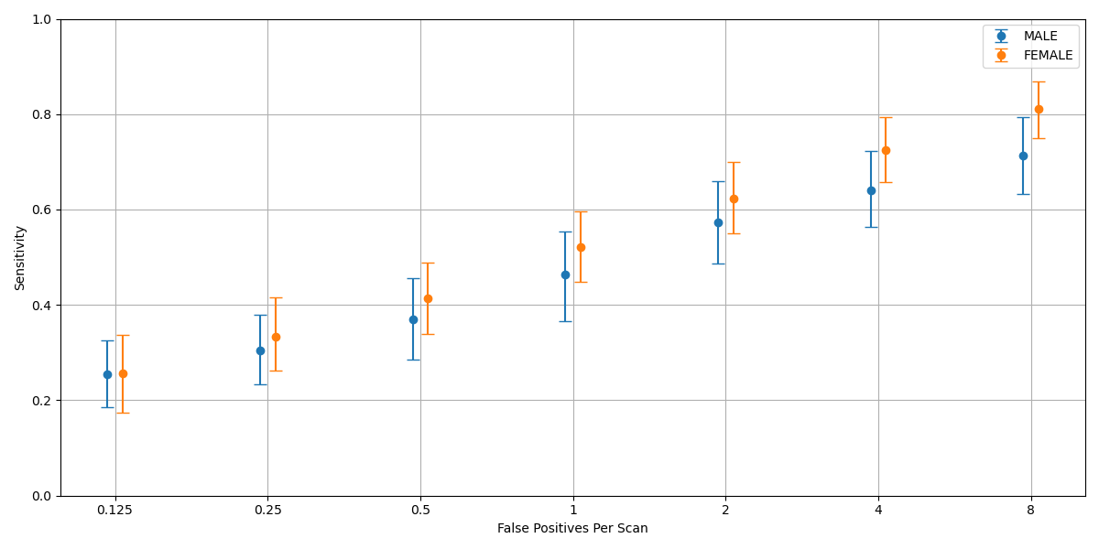
Sample: Test Balanced – Gender Splits – FROC and CPM
Model: Grt123
Model: Detection
Model: TiCNet
Actionable and Non-Actionable
Male Scans: 399
Male Nodules: 553
Female Scans: 399
Female Nodules: 552
MALE | 0.48 (95% CI 0.43-0.52)
FEMALE | 0.47 (95% CI 0.42-0.52)
MALE | 0.58 (95% CI 0.52-0.63)
FEMALE | 0.56 (95% CI 0.51-0.61)
MALE | 0.51 (95% CI 0.46-0.56)
FEMALE | 0.53 (95% CI 0.48-0.58)
Model: Grt123
Model: Detection
Model: TiCNet
Actionable only
Male Scans: 399
Male Nodules: 198
Female Scans: 399
Female Nodules: 216
MALE | 0.51 (95% CI 0.43-0.6)
FEMALE | 0.49 (95% CI 0.42-0.57)
MALE | 0.45 (95% CI 0.37-0.53)
FEMALE | 0.47 (95% CI 0.41-0.54)
MALE | 0.47 (95% CI 0.39-0.56)
FEMALE | 0.53 (95% CI 0.45-0.60)

Slide 9
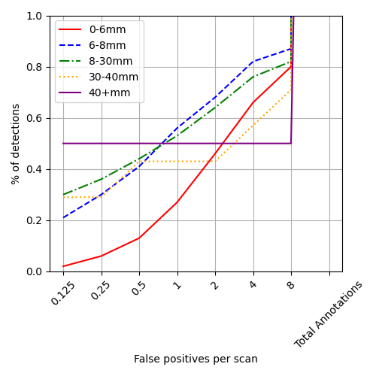
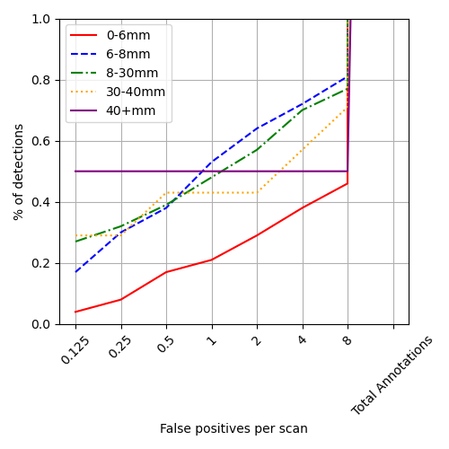
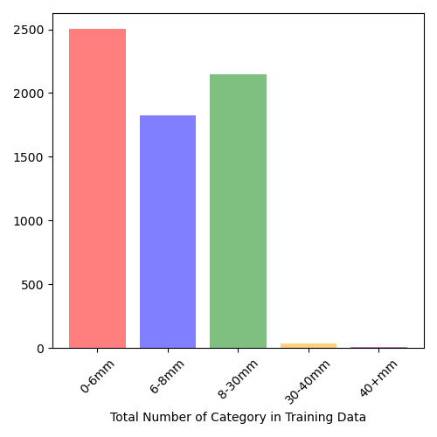
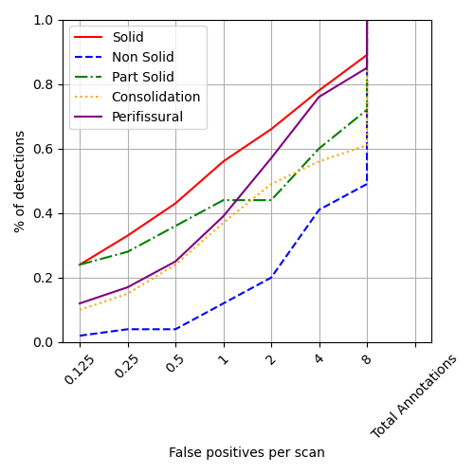
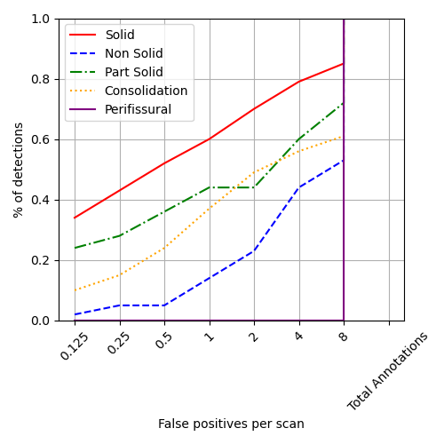
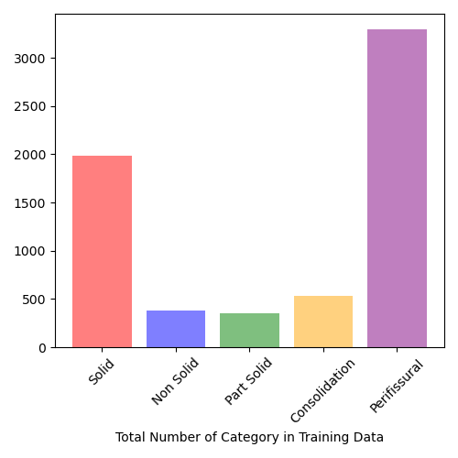
Performance Drivers - Nodule Characteristics – Model: GRT123
Actionable & Non-Actionable Nodules
Actionable Only Nodules

Slide 10
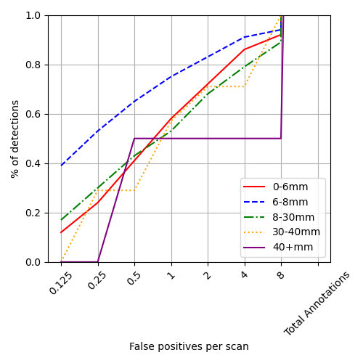
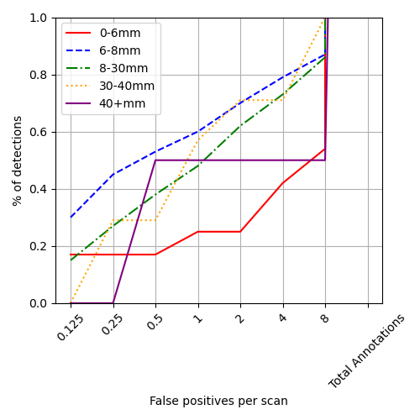


Performance Drivers - Nodule Characteristics – Model: Detection
Actionable & Non-Actionable Nodules
Actionable Only Nodules

Slide 11




Performance Drivers - Nodule Characteristics – Model: TiCNet
Actionable & Non-Actionable Nodules
Actionable Only Nodules

